Slide 1
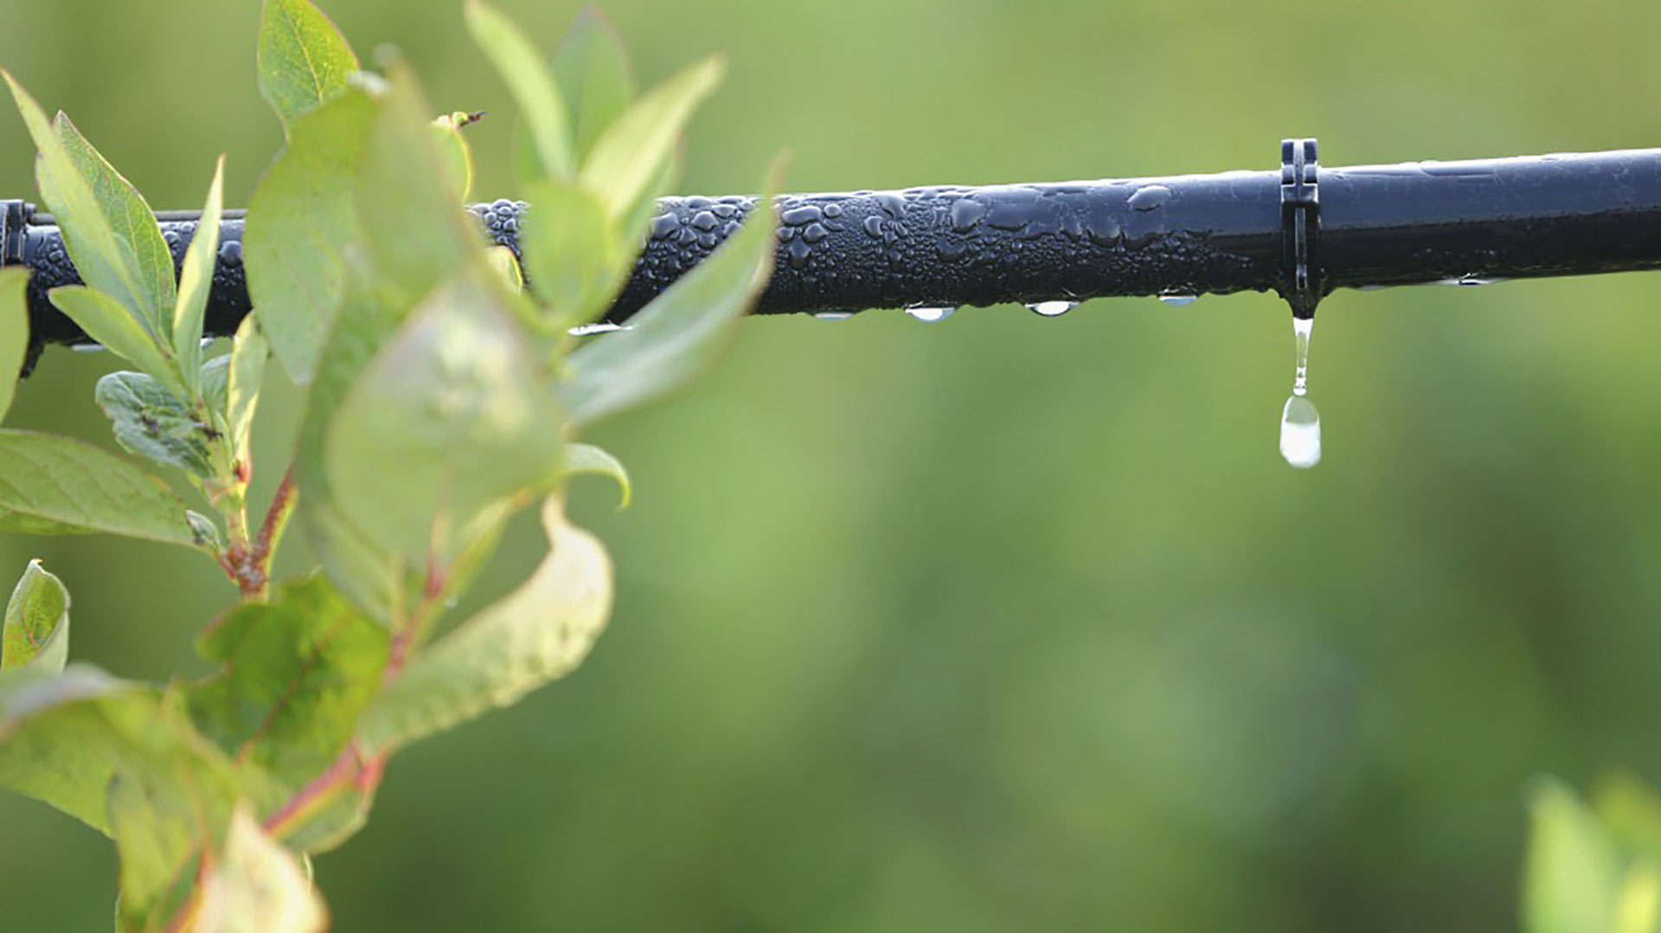
Materials for GSA Outreach January 2019

Slide 2
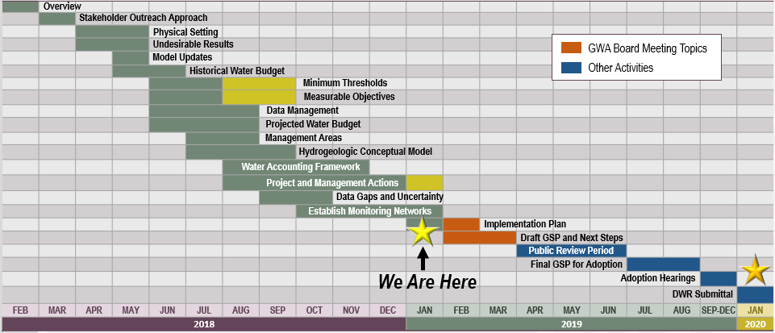
GSP Topics & Project Schedule
GSP Topics
GSP Finalization Elements
2

Slide 3
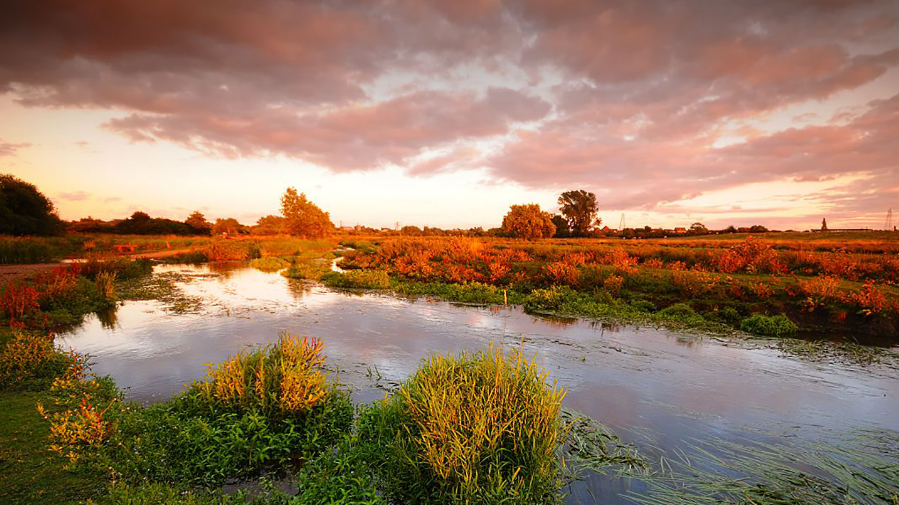
Outreach Update

Slide 4
Groundwater Sustainability Workgroup Update
7 Workgroup members and 1 member of the public attended the Situation Assessment presentation held on December 12th
The next Workgroup meeting will be held on January 9th at the San Joaquin County Public Works Department
Notes from the October Workgroup meeting are available on the website, esjgroundwater.org (under ‘Agendas’ tab)
4

Slide 5
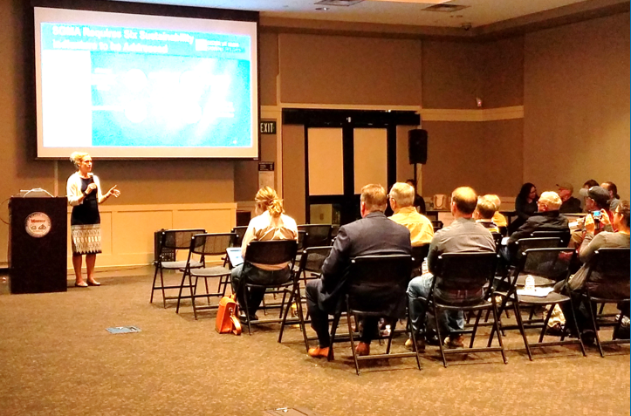
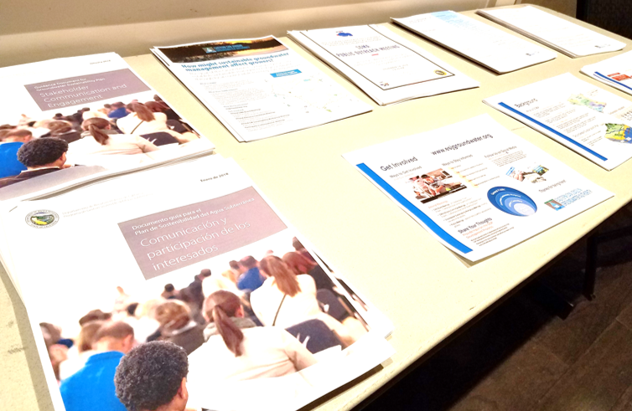
Third Informational Meeting
The third informational meeting/open house will be held in the February timeframe
Additional information will be posted to the website, esjgroundwater.org
5

Slide 6
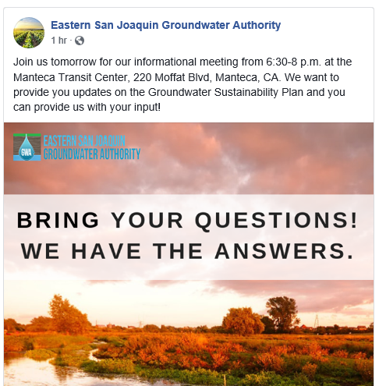
Reminder – The GWA is on Facebook
The ESJ GWA Facebook page provides updates on GSP development and upcoming events
You can like the page, share posts, or tag the page in your own posts www.facebook.com/ESJGroundwaterAuthority
6

Slide 7
Projects and Management Actions
4

Slide 8
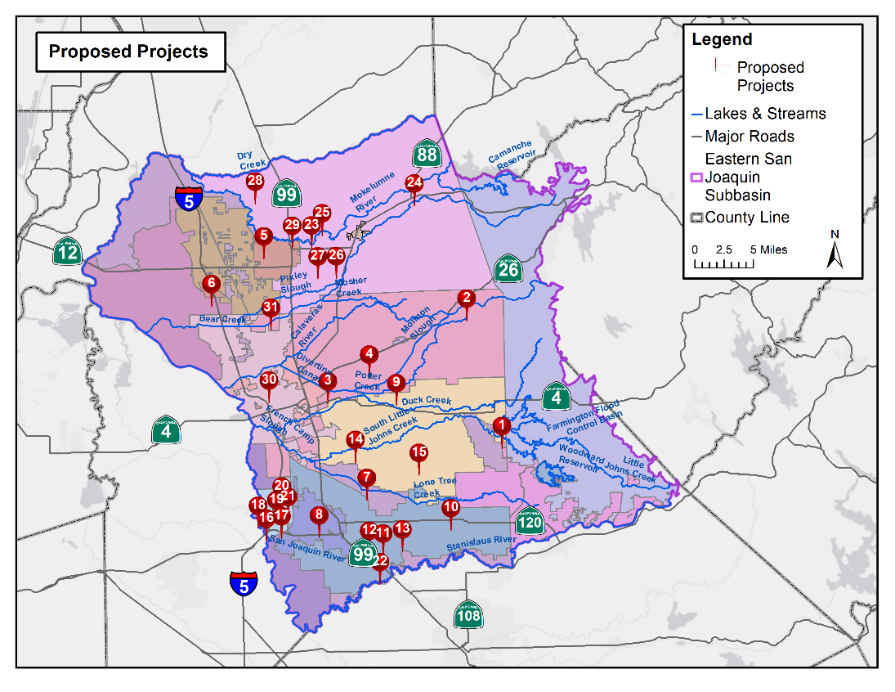
Project Locations
31 Proposed Projects Received To-Date
1 – Farmington Dam Repurpose Project
2 – Lake Grupe In-Lieu Recharge
3 – Raw Water Reliability and Recharge
4 – SW Implementation Expansion
5 – SW Facility Expansion & Delivery Pipeline
6 – White Slough WPCF Expansion
7 – Recycled Water Transfer to Agriculture
8 – Demand Management Measures
9 – Water Transfers to SEWD and CSJWCD
10 – Increase Nick DeGroot SW Deliveries
11 – City of Escalon Wastewater Reuse
12 – South San Joaquin Stormwater Reuse
13 – Pressurization of SSJID Facilities
14 – BNSC Intermodal Facility Recharge Pond
15 – CSJWCD Capital Improvement
16 – Recycled Water Program Expansion
17 – LAS-3 Percolation Basin
18 – Conjunctive Use of GW and SW
19 – UWMP Water Conservation
20 – NPDES Phase 2 MS4 Compliance
21 – Water Meter Improvements
22 – City of Ripon Surface Water Supply
23 – Cal Fed GW Recharge Project
24 – Mokelumne River Loss Study
25 – North System Modernization 26 – PDA Banking
27 – South System Modernization 28 – Tracy Lakes GW Recharge 29 – Winery Recycled Water
30 – Advanced Metering Infrastructure
31 – Mobilizing Recharge Opportunities
8

Slide 9
A Range of Project Types are Represented
Recharge
Surface Water Supplies (In-Lieu Recharge)
Water Recycling
Conservation & Demand Management
Intra-Basin Transfers
Stormwater Use
Technical Studies
9

Slide 10
Projects and Management Actions Will Be Used to Meet Overdraft
Total Water Use
Surface Water
Projected Condition
OVER-DRAFT
Groundwater
Surface Water
Sustainable Condition
Sustainable Groundwater Yield
Projects
10

Slide 11
Pathway to Project Implementation
1. Approach
2. Funding
3. Implementation
Regional-scale
Subregional-scale
GSA-scale
Regional
GSA
Regional JPA
Subregion GSAs
11

Slide 12
Project Assessment
4

Slide 13
Project Assessment Process
The Advisory Committee developed and ranked a series of 6 assessment criteria
Projects were scored against each criterion
Each GSA was met with individually to confirm project details and review scoring process
13

Slide 14
Assessment Criteria
Implementability
Location / Proximity to Area of Overdraft
Cost per Volume Water Savings
Environmental Benefit / Impact
Disadvantaged Community Benefit
Water Quality Impact (Positive or Negative)
14

Slide 15
Project Portfolios
4

Slide 16
Project Portfolio Development Process
Workshop was held to identify basin priorities
Feedback was used to identify 9 portfolio themes to meet the needs of the basin
Projects were evaluated and compared
Next Steps:
Refine/optimize selected portfolios
Address undesirable results through GSA-scale projects
16

Slide 17
Preliminary Project Portfolios
Preliminary portfolios are being developed to package projects most in line with these criteria:
Cost-Effectiveness
Regional Diversity
Minimized Infrastructure
Environmental Benefit
DAC Benefit
Impact on Cone of Depression
Fast Implementation
Small-Volume Projects
Large-Volume Projects
17

Slide 18
Monitoring Network and TSS Wells

Slide 19
Technical Support Services (TSS) Funding Update
Review: DWR’s Technical Support Services provides funding to construct monitoring wells in areas where data gaps exist
At the November meeting, the GWA Board voted to authorize the Basin Coordinator to submit the TSS application with the 3 identified monitoring well locations
19

Slide 20
3 Locations Identified for TSS Wells
Dry Creek
Surface water interaction
Potential GDEs
Cosumnes Subbasin
Low GW levels
These locations were recommended based on their ability to assess sustainability and support future projects
Calaveras/Hwy 88
Surface water interaction
Low GW levels
Duck Creek/Stan. Co.
No nearby wells
Surface water interaction
Potential GDEs
Shallow / low cost site
20

